Slide 1
An Ensemble Model for Hope Speech Detection from YouTube Comments
Team NO: 12
Name: Puspita Das
ID: 20301246
Sec: 01
ST & RA: Farah & Amit

Slide 2
Outline
Introduction
Motivation
Contribution
Methodology
Dataset
Result
Conclusion
Limitation
Synthesis
.

Slide 3
Introduction
Hope and Hate speech approaches on online platform
Different techniques to identify YouTube comments on numerous languages
Work on different numerous languages on Hope speech
.

Slide 4
Motivation
Encourages to spread optimism
Reducing hate comments that affect individual’s life
Promoting and increasing positive comments

Slide 5
Contribution
Hope comments detection from YouTube comments
Using different languages to expand hope comments
Detecting Non hope speech through different classifiers

Slide 6
Methodology
Algorithms of machine learning to test the five distinct languages
Data statistics of division of non Hope and Hope speech and labels
Data statistics of Hope speech vary based on different types of languages
Performance of features on Random Forest Classifiers and others

Slide 7
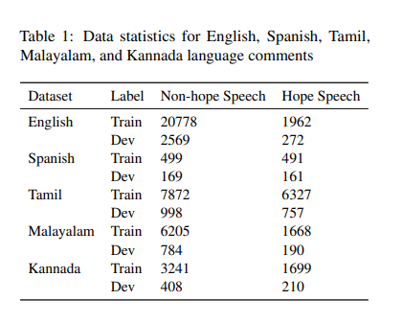
Dataset
Hope speech of English has 1962 words whereas Non Hope speech has lot (Kumar et al., 2022)
In training, Spanish has less which is 499 compared to English Non-hope speech
Tamil, Malayalam, Kannada have more Hope speech than Spanish

Slide 8
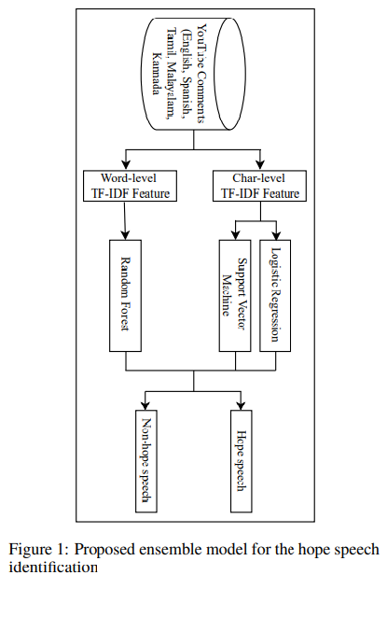
Proposed Model
YouTube Comments classified into two parts
Using three types of machine learning to get the best classification
Tracing Hope and Non Hope speech after preprocessing and testing

Slide 9
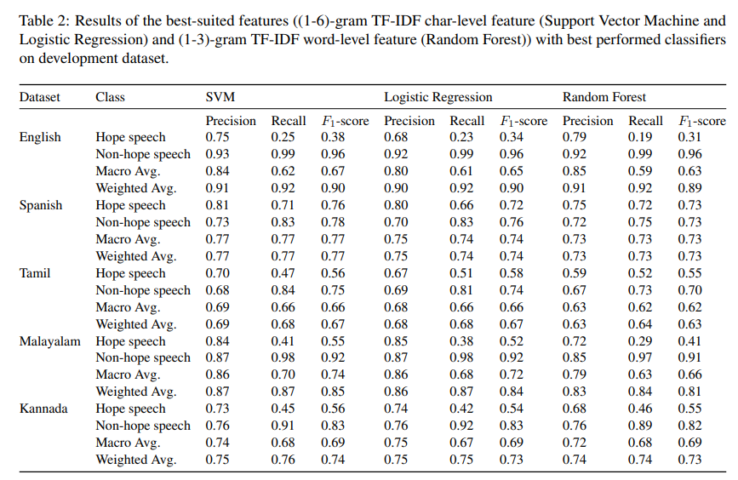
Result: Best-suited features with on development dataset
In English dataset, the proposed model achieved a macro precision, recall, F1-score of 0.460, 0.370 and 0.380 (Kumar et al., 2022)
A macro precision of 0.490, a macro recall of 0.470, a macro F1-score of 0.470 for the Kannada language (Kumar et al., 2022)

Slide 10
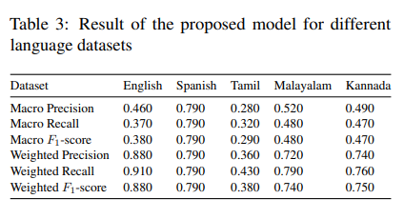
Result of the proposed model
Proposed ensemble model achieved a macro F1-scores of 0.380, 0.790, 0.290, 0.480, and 0.470 for English, Spanish, Tamil, Malayalam, and Kannada language YouTube comments (Kumar et al., 2022)
Char-level features significant performance

Slide 11
Conclusion
Exploration of Hope speech from YouTube comments by using N-gram level
Proposed model’s scores on different languages
Best classification and features on various perspectives

Slide 12
Limitation
First Limitation: Unable to identify some kind of symbols or signs in comments
Second Limitation: Difficulty to understand and identify the sarcasm and context of specific characteristics

Slide 13
Synthesis
Detecting hope and non hope speech from other social medias or platforms
Finding hope and non hope words in various languages or symbols
Removing negative signs or words from the comments

Slide 14
Reference
K, Abhinav., S, Sunil., & R, Pradip. (2022). SOA_NLP@LT-EDI-ACL2022: An Ensemble Model for Hope Speech Detection from YouTube Comments. In Proceedings of the Second Workshop on Language Technology for Equality, Diversity and Inclusion, pages 223–228, Dublin, Ireland. Association for Computational Linguistics.

Slide 15
Thank You

